Slide 1

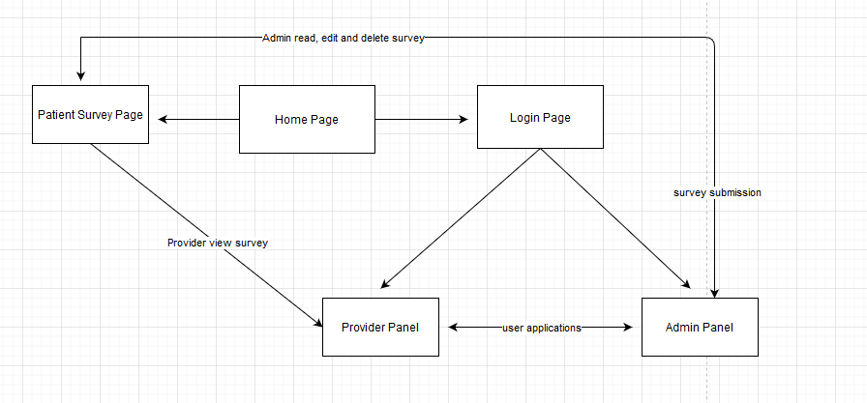
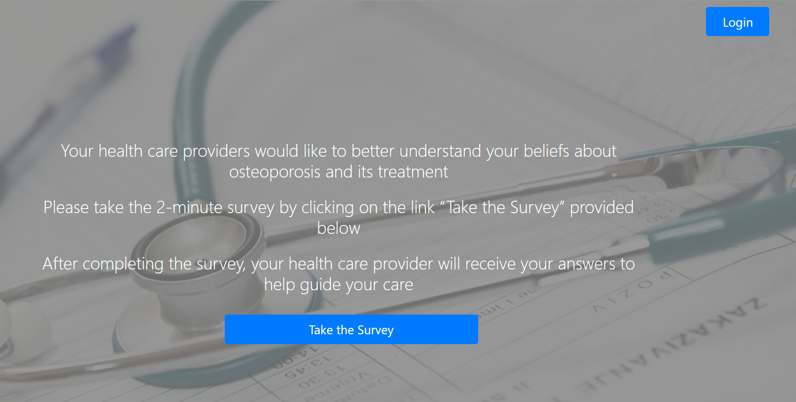
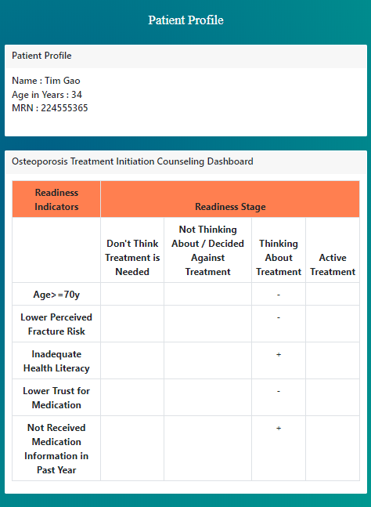
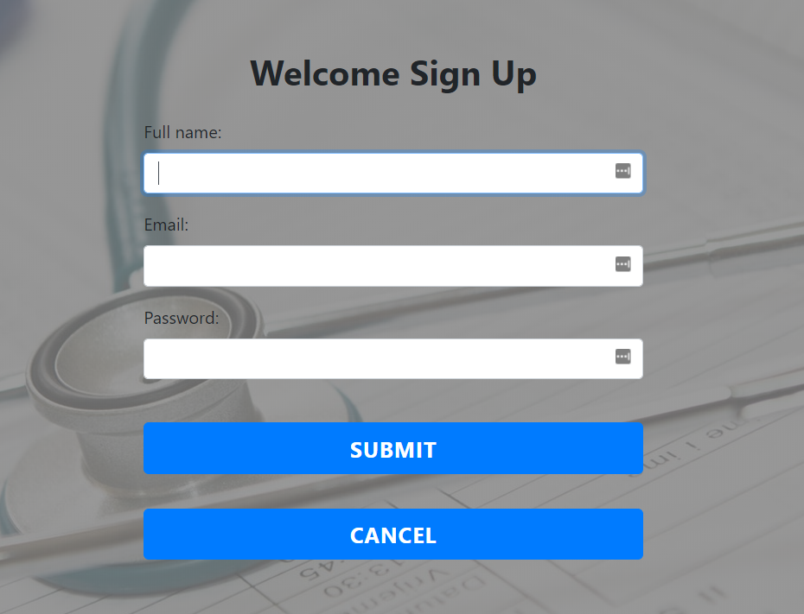
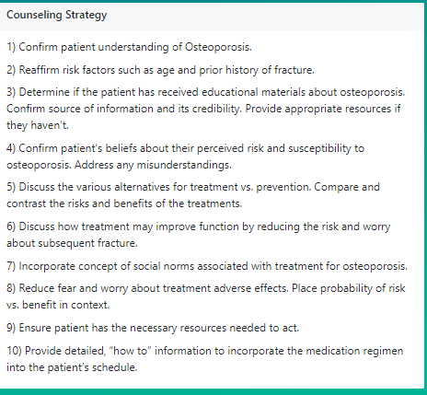
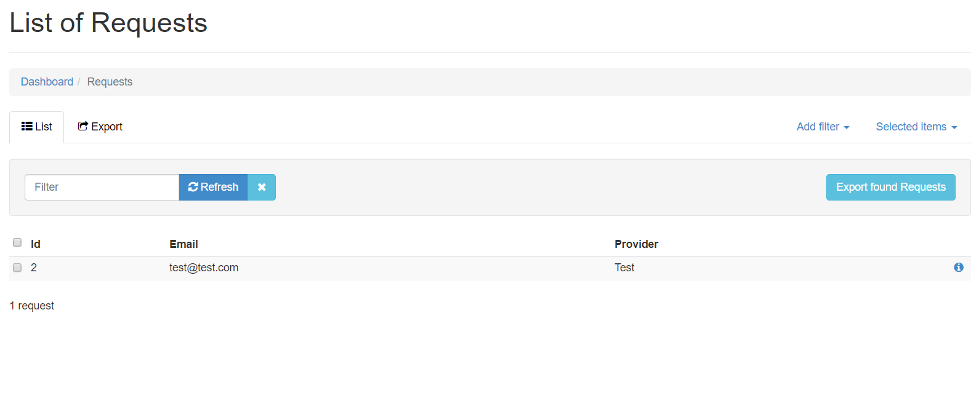
Medical Persistence System
Product Owner: Weicheng Gan
Scrum Master: Yunzhi Tang
Team Members: Tianyang Ding, Junyu Han, Xiangqi Jiang, Yijun Zhang, Lida Zhang
Introduction
Design Diagram
Final Product
Osteoporosis and low bone mass affect over half of the population aged 50 or older in the United States and thus it’s critical for medical providers to understand patients’ awareness of osteoporosis. This project aims at creating a website, through which patients will fill out surveys and providers will use these surveys to analyze and provide corresponding treatments. This website is composed of three sections: patients surveys, medical providers feedback, and web administrator control.
User Story
Legacy Code
Previous teams have created a basic system that contains the fundamental features: patients surveys, medical providers’ analysis, and web admin control. However, both the medical providers’ analysis and web admin control sections lack features such as provider sign-up and counseling strategies indication. Also, the front UI can be further improved
User Story 1: Introduction Page should be more user-friendly and less intimidating
User Story 2: Improve the layout of website to provide better clarification for patients
User Story 3: Ensure the website is also functional on mobile devices and tablets
User Story 4: Create a sign-up mechanism where providers can sign up on the website for administrator to approve
User Story 5: Add admin a sign-up approval tab for admin to approve/disapprove pending provider application
User Story 6: Validate sign-up record with password/email validator

